Slide 1
Architecting Fabric Solutions
It‘s not just the size that matters
Tom Martens @ Microsoft Fabric User Group Hamburg
2025-04-10

Slide 2
Content
Who I am
What this session is about
A Recap
Workspace apps vs Org apps
What we have to consider

Slide 3

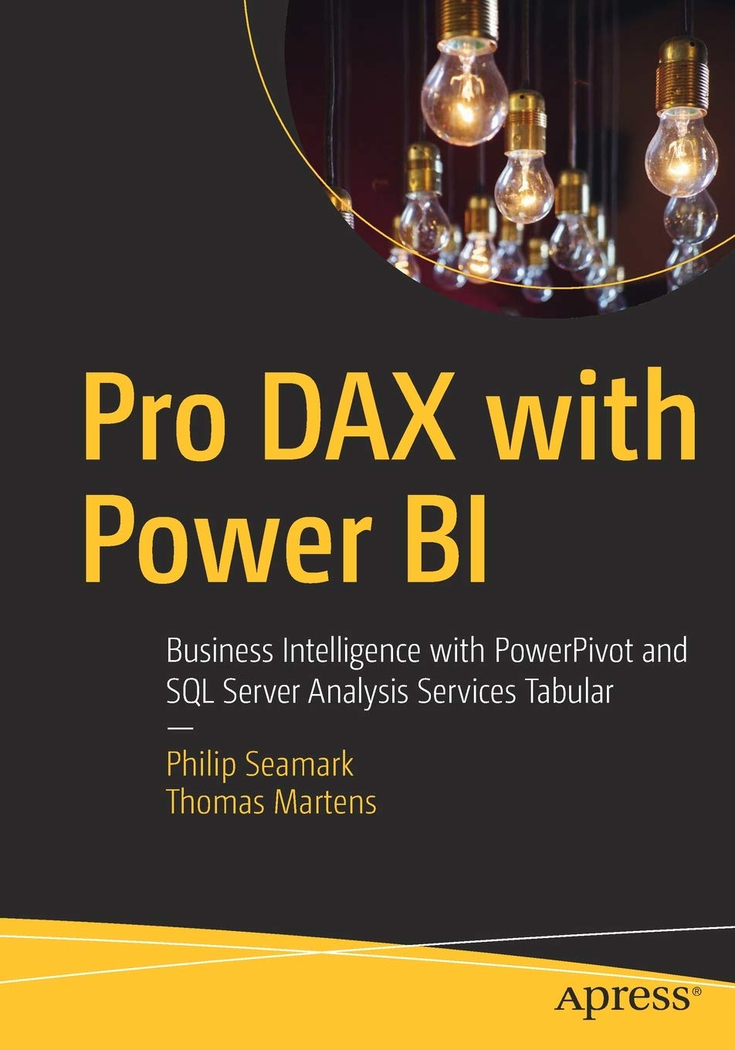
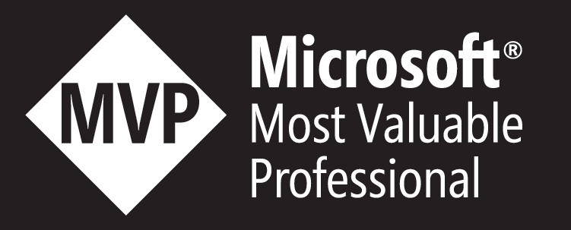
Tom Martens
25+ years of experience designing analytical solutions using the MSFT data platform
Solution Architect @ Munich Re
/tommartens68
@tommartens68

Slide 4

What this session is about

Slide 5
What this session is about
In this session I will not talk about the size (maybe a little), instead I'm focusing on the where, meaning the location of a Microsoft Fabric item. I will talk about the Fabric workspace and the F-capacity and how the location of an item will impact governance, performance, and the experience of an end-user (whoever this will be). But it's not just the where (the location), it's also the what - how different workloads will affect the placement of items, this is not just about separating workloads into different workspaces but also considering to spread workloads across different capacities.
This session reflects the state of my current experience about architecting "Fabric solutions", some statements are "I have seen it" examples and some statements need some "real-life experience."
There will be some "fun" anecdotes as well.

Slide 6
Data Mesh - a new architectural concept
Data mesh is a cultural and organizational shift for data management focusing on federation technology that emphasizes the authority of localized data management. Data mesh is intended to enable easily accessible data by the business. Data assets are analyzed for usage patterns by subject matter experts, who determine data affinity, and then the data assets are organized as data domains. Domains are contextualized with business context descriptors. Subject matter experts use the patterns and domains to define and create data products. Data products are registered and made available for reuse relative to business needs.
https://www.gartner.com/en/information-technology/glossary/data-mesh

Slide 7
Data Mesh - a new architectural concept
Data mesh is a cultural and organizational shift for data management focusing on federation technology that emphasizes the authority of localized data management. Data mesh is intended to enable easily accessible data by the business. Data assets are analyzed for usage patterns by subject matter experts, who determine data affinity, and then the data assets are organized as data domains. Domains are contextualized with business context descriptors. Subject matter experts use the patterns and domains to define and create data products. Data products are registered and made available for reuse relative to business needs.
https://www.gartner.com/en/information-technology/glossary/data-mesh

Slide 8
Data Product
A data product is an outcome that is generated from data analysis or processing. It can take various forms, such as conformed dimensions, shared datasets, reports, dashboards, visualizations, or predictive models.
Data products are designed to provide insights, support decision-making, and drive actions based on data.
In the context of a data mesh, each local data authority takes ownership of their data products. They define the structure, quality, and usage of their data products, and interfaces (maybe APIs) for other teams to reuse the data product.

Slide 9
Data Product
A data product is an outcome that is generated from data analysis or processing. It can take various forms, such as conformed dimensions, shared datasets, reports, dashboards, visualizations, or predictive models.
Data products are designed to provide insights, support decision-making, and drive actions based on data.
In the context of a data mesh, each local data authority takes ownership of their data products. They define the structure, quality, and usage of their data products, and interfaces (maybe APIs) for other teams to reuse the data product.

Slide 10

A little recap

Slide 11





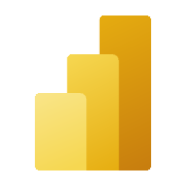

Microsoft Fabric – under the hood (a gentle glimpse)
Unified storage (Delta Parquet Format)
Delta Lake is the open table storage format that Microsoft Fabric has standardized on, supporting capabilities like ACID transactions, time travel, schema evolution and more.
Delta Lake enables ‘OneCopy’ allowing all Microsoft Fabric compute engines to seamlessly share data
All Microsoft Fabric artifacts automatically write Delta with V-Order optimization providing lightning-fast analytics on Vertiscan for reporting with Power BI
‘Load to Delta’ in the lakehouse unlocks a visual experience to load common file formats and folders to Delta
Synapse Data Warehousing
Synapse Data
Engineering
Data
Factory
Synapse Data
Science
Synapse Real
Time Analytics
Power BI
Serverless
Compute
T-SQL
Spark
KQL
Analysis Services
Warehouse
Lakehouse
Kusto DB
Dataset
Delta – Parquet Format
Delta – Parquet Format
OneLake
Delta – Parquet Format
Delta – Parquet Format

Slide 12


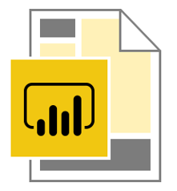
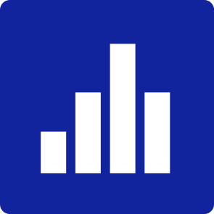
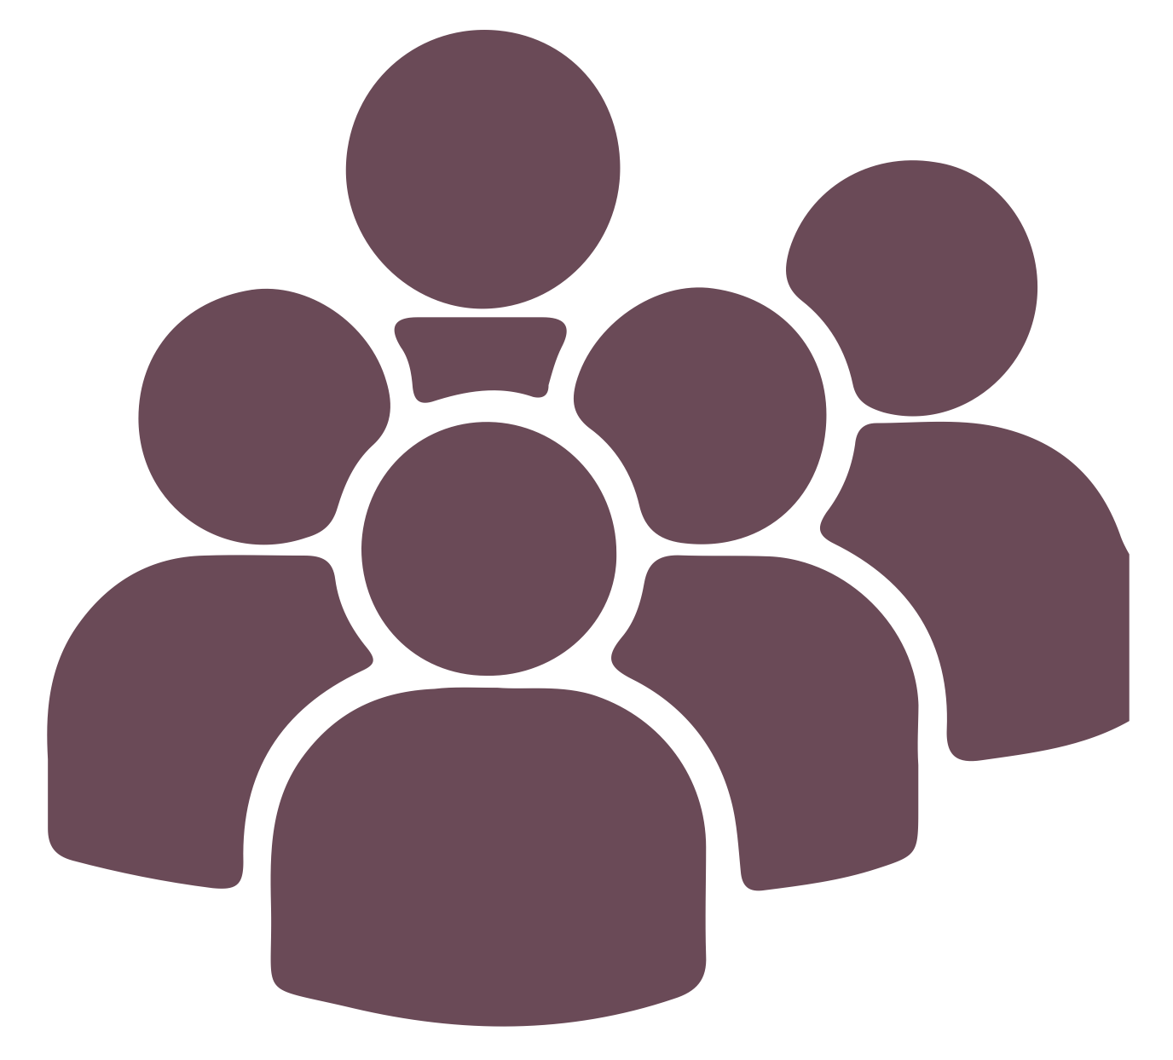
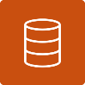





Separate the data from the content and Multiple Audiences
Try to use shared datasets, this will not just save resources by reducing the amount of data refreshes.
Data workspace
Content workspace(s)
Multiple Audiences
Create a data workspace and consider a workspace being an Analysis Services Tabular instance!

Slide 13
Separate the data from the content (w/o Org apps)
Try to use shared datasets, this will not just save resources by reducing the amount of data refreshes.
Data workspace
Content workspace(s)
Create 1 to n content workspaces
This allows to address different audiences consuming the same data but are not using the same content!
Content creators have at least the contributor role assigned in the content workspace
Content creators are connecting to the Power BI dataset
Content creators are not members of the data workspace
Content creators need Build Permission on the dataset
Row Level Security will be honored if data and content workspaces are separated
Create a data workspace and consider a workspace being an Analysis Services Tabular instance!

Slide 14
Separate the data from the content (now using Org apps)
Try to use shared datasets, this will not just save resources by reducing the amount of data refreshes.
Data workspace
Content workspace (only 1)
Create 1 to n Org apps)
This allows to address different audiences consuming the same data but are not using the same content!
Content creators have at least the contributor role assigned in the content workspace
Content creators are connecting to the Power BI dataset
Content creators are not members of the data workspace
Content creators need Build Permission on the dataset
Row Level Security will be honored if data and content workspaces are separated
Create a data workspace and consider a workspace being an Analysis Services Tabular instance!

Slide 15
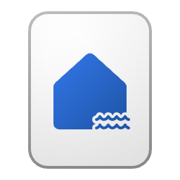
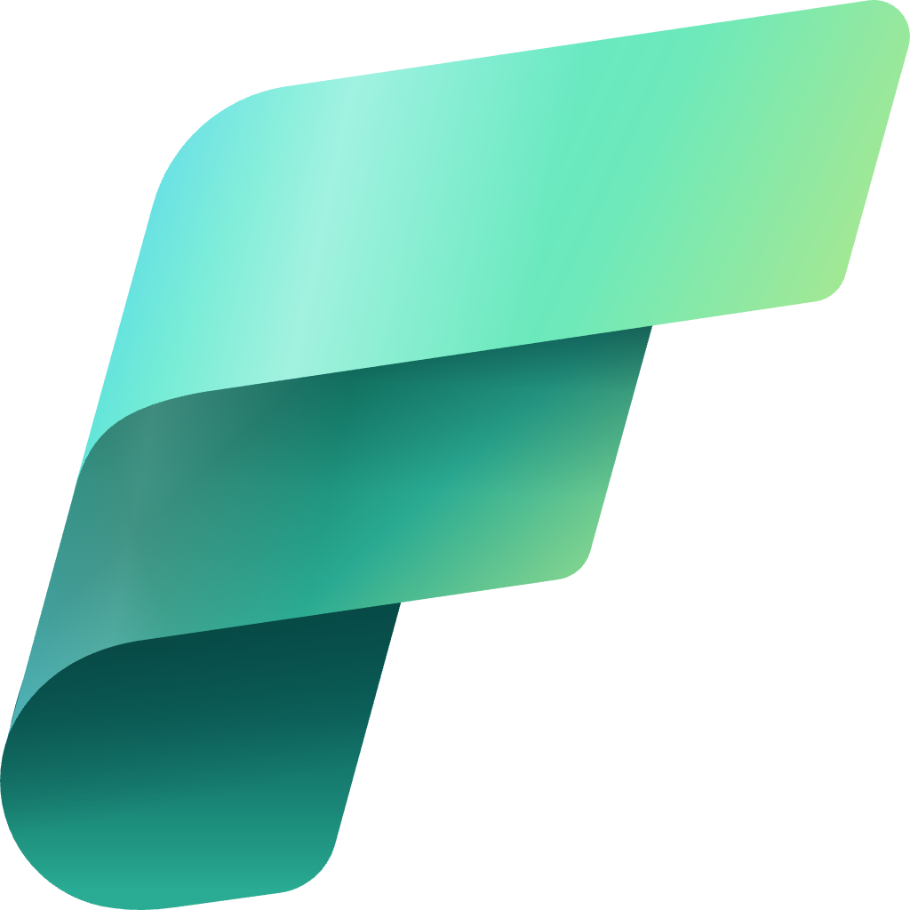
Customize your medallion architecture
Depending on your organization's specific use case, you may have a need for more layers or think about spreading the layers across workspaces.
Gold Layer
Harvesting insights
Bronze
Silver
Gold
Silver Layer
Creating structure
Bronze Layer
Get all the data
A larger Fabric capacity
A smaller Fabric capacity
Raw Layer
Notes:
Depending on your organization's specific use case, you may have a need for more layers. For example, you might have an additional "raw" layer for landing data in a specific format before it's transformed into the bronze layer. Or you might have a "platinum" layer for data that's been further refined and enriched for a specific use case. Regardless of the names and number of layers, the medallion architecture is flexible and can be tailored to meet your organization's particular requirements.

Slide 16
And now …

Slide 17
The location
One Domain (or one data product)
Azure Datacenter
Fabric capacity
If there is one data product, and basically one app → …
Workspace (data product 1)

Slide 18
The location
One Domain (or one data product)
Azure Datacenter 1
Fabric capacity
If there is one data product, and basically one app → life is good
Workspace (data product 1)

Slide 19
The location
Multiple domains (more than one data product)
Azure Datacenter 1
Fabric capacity
If there is one data product (but they are independent), and basically one app per data product → life is still good
Workspace (data product 1)
Workspace (data product 2)

Slide 20
The location (now it becomes interesting)
Multiple domains (more than one data product)
Azure Datacenter 1
Fabric capacity
If there are more data products (but they are NOT independent), life becomes complex
The owner of “data product 1” provides input to “data product 2”
either by using a shortcut
Or by simply copying the data
→ but then, how do we make sure that the “data product 2” is accessing only the necessary data
➔ make sure you get accustomed with OneLake data access roles
Workspace (data product 1)
Workspace (data product 2)

Slide 21
The location (now it becomes interesting)
Multiple Domain (more than one data product)
Azure Datacenter 1
Fabric capacity
If there are more data products (but they are NOT independent), life becomes complex
The owner of “data product 1” provides input to “data product 2”
either by using a shortcut
Or by simply copying the data
→ but then, how do we make sure that the “data product 2” is accessing only the necessary data
➔ make sure you get accustomed with OneLake data access roles
Workspace (data product 1)
Workspace (data product 2)

Slide 22
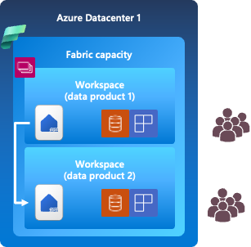
The location (now it becomes interesting)
Multiple domains (more than one data product), multiple locations
Azure Datacenter 2
Now ”data product 3” is located in a different Azure data center, this can be due to regulatory requirements (this compliance thingy) or simply due risk mitigation reasons
The owner of “data product 2” provides input to “data product 3”
either by using a shortcut
Or by simply copying the data (if this is allowed by regulatory requirements)
→ but then, how do we make sure that the “data product 2” is accessing only the necessary data
➔ make sure you get accustomed with OneLake data access roles
Fabric capacity
Workspace (data product 3)

Slide 23

Think! Even better, think twice!
Microsoft Fabric is epic, no question. But this does not mean we can stop thinking ☺

Slide 24
Resources
Readings
OneLake Security: https://blog.fabric.microsoft.com/en-gb/blog/the-next-evolution-of-onelake-security-enters-early-preview?ft=All
Until then, OneLake data access roles: https://learn.microsoft.com/en-us/fabric/onelake/security/get-started-data-access-roles
OneLake data access roles in action: https://publish.obsidian.md/minceddata/Blog/Way+of+working/The+way+of+working+(part+2)+in+the+era+of+Microsoft+Fabric+-+The+location+of+the+semantic+model
Spark Autoscaling: https://blog.fabric.microsoft.com/en-us/blog/introducing-autoscale-billing-for-data-engineering-in-microsoft-fabric?ft=All

Slide 25
Thank you!
/tommartens68
@tommartens68

